Slide 1

Better Together
Utilizing Open Source Technology to Enhance and Streamline Research Analysis

Slide 2
Agenda
Objective
Background / Process
Tools and Technology
What’s in a Metric?
Other Considerations
Application
Current Setup
Future Ideas
Closing Remarks

Slide 3
Objective
To create a framework that streamlines accessibility analysis for the NYC metro area utilizing open source technologies.
Goal – Making Analysis and Research Easier and More Timely

Slide 4
Open Source vs. Proprietary Software
Benefits
Costs
Lower financial cost
More collaborators in academic and professional space
Ability to “own the tool” and customize the implementation
More upfront investment of time to create and maintain framework
Lack of access to proprietary tools or private data sources

Slide 5
Which Tool to Use?
Both Python and R are robust tools for analysis with a rich ecosystem of community and extensions for geospatial work.
R is generally better suited for research-oriented considerations for the following reasons:
Direct interface with pertinent information sources (e.g., demographic information from Census Bureau, OpenTripPlanner travel time calculations)
Extensions that enable document creation or reporting dashboard without needing to learn other programming tools.
Potentially mention Rmarkdown

Slide 6
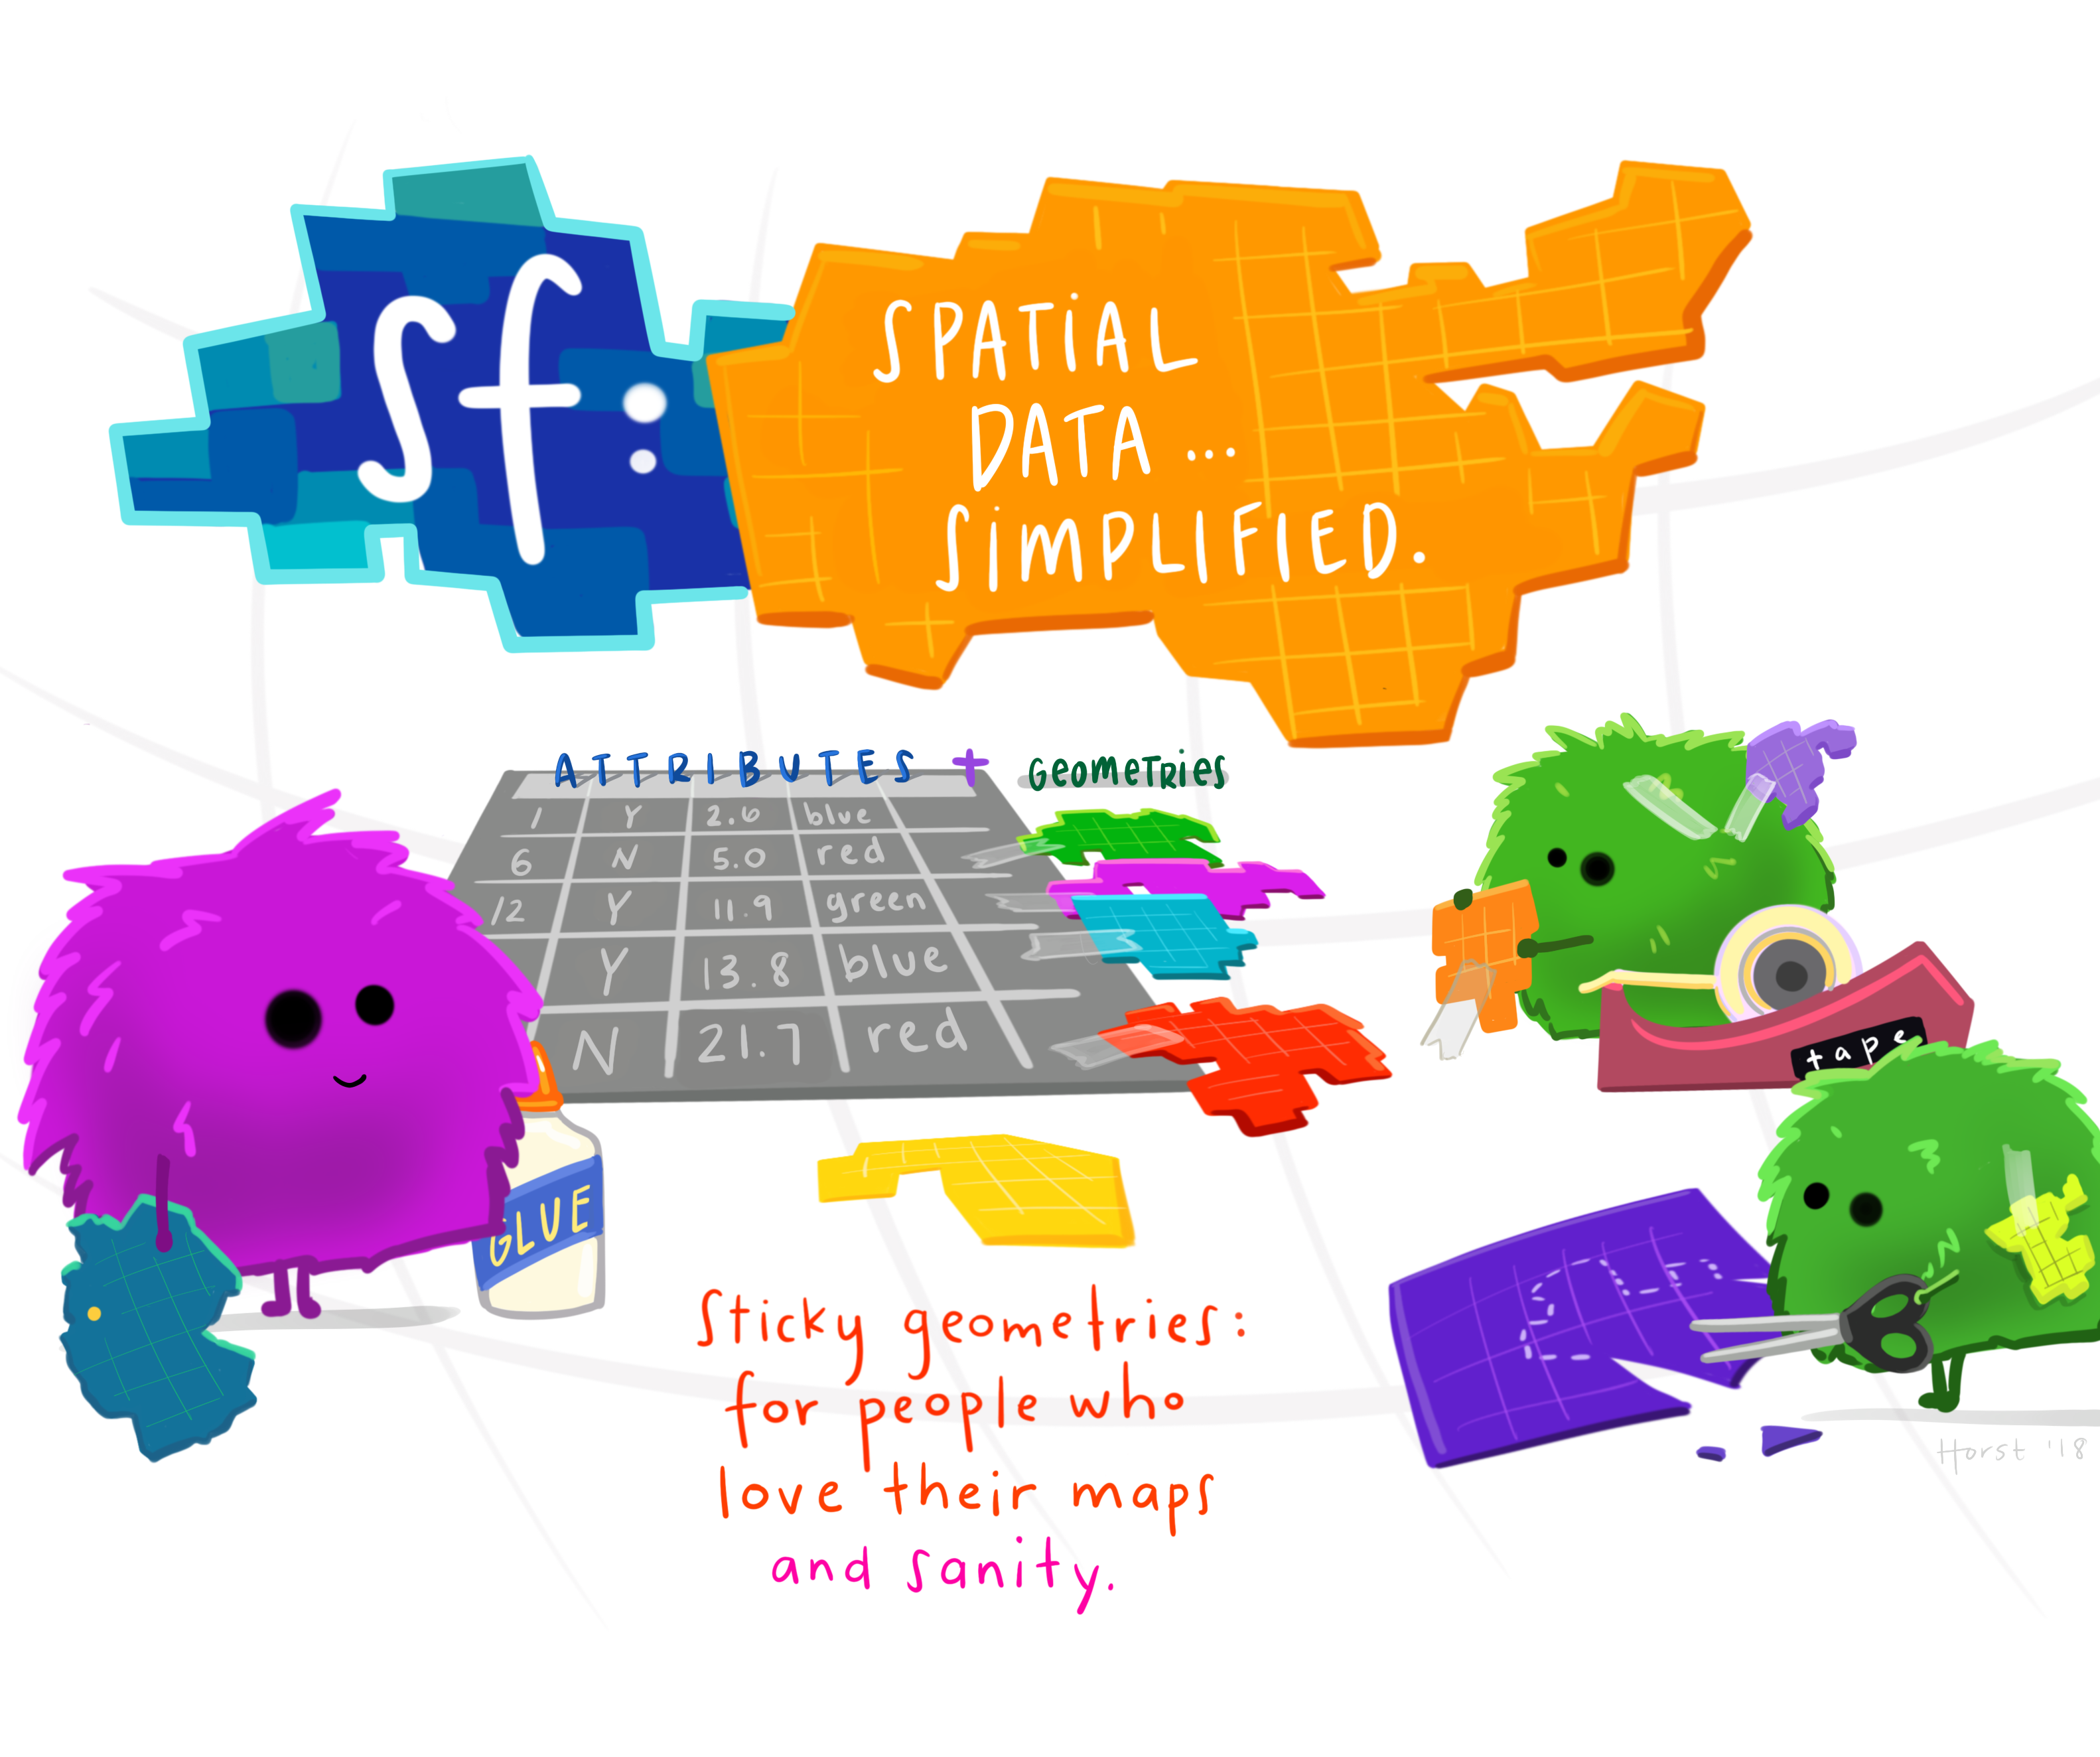
R and Spatial Data
Artwork by @allison_horst

Slide 7
What’s in a Metric?
Metric - A single number meant to objectively reflect a multitude of considerations about a given reality.
Accessibility metrics
Two Main Inputs: Distance and Number of Resources
Population*

Slide 8
Weighted Access Index
Sum of Number of Resources / Travel Time
Example:
A Census Tract has 1 hospital in its “home” census area, 2 hospitals that are in another Census Tract that is 20 minutes away and 10 that are in a Census Tract that is an hour away.
Weighted Access Index for hospitals in this Census Tract would be:
1 hospital / 1 minute (nominal travel time) + 2 / 20 minutes + 10 / 60 minutes => 1 + 0.10 + 0.16 = 1.16.

Slide 9
Going the Distance – Measuring Travel Time
Two Approaches:
Point-to-Point
Area-to-Area
Two Methods to Calculate
Directly calculate with a tool such as OpenTripPlanner or GoogleMaps API
Pre-computed travel times from University of Chicago*(only works with Area-to-Area)

Slide 10
Application
Current Structure
Walkthrough
Notes:
Evaluate a set of communal resource
Scope is focused on PUMAs (Public Use Microdata Areas)
Generally relate one-to-one with Community District with a few exceptions.
Pre-computed mass transit times

Slide 11
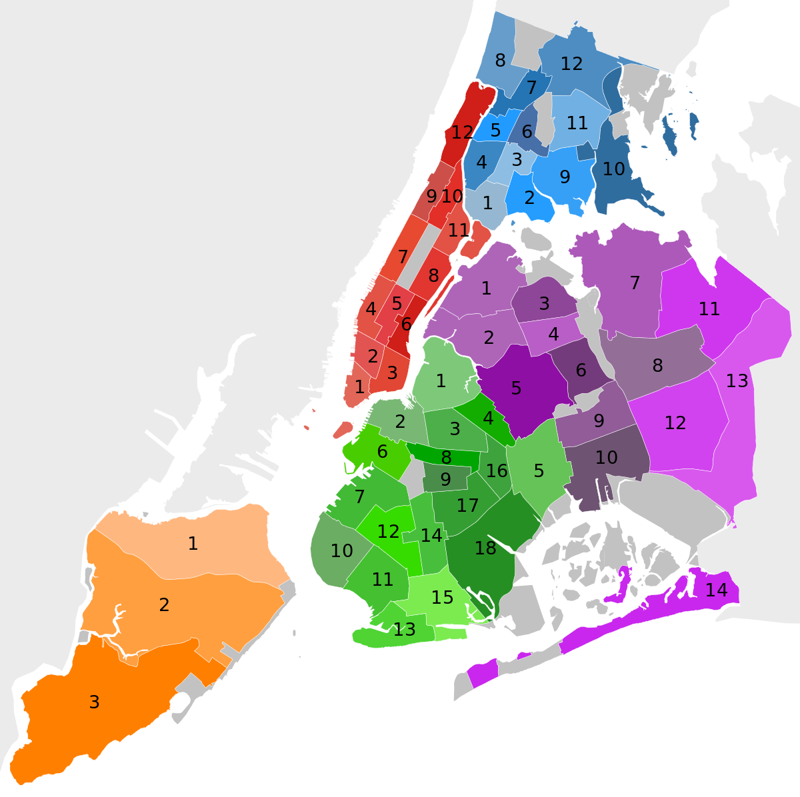
Future Ideas
Three primary areas:
Level of analysis – allow for Census Block or Census Tract
Flexibility in metric calculation:
Different metrics for different resources
Different weighting of travel time per asset category
Composite Score
Support more analysis and information discovery within the application

Slide 12

Thank you

